Slide 1
Introduction to Intelligent Vehicles [ 7. Intersection Management ]
Chung-Wei Lin
cwlin@csie.ntu.edu.tw
CSIE Department
National Taiwan University
Fall 2019

Slide 2
Announcement
Homework
Homework 2
Graded?
Reminder: if you answer M = 2018…
Reminder: signal packing
Regrade request due on October 30 (Wednesday) 11:59pm
Homework 3
Will be posted before or on November 4 (Monday)
Due on November 25 (Monday) noon
Project
Proposal
Due on November 18 (Monday) noon

Slide 3
Where Are We Now?
Four parts in sequence
[Part 1] Preliminary
[Part 2] Applications
[Part 3] Intelligent Technology
[Part 4] Advanced Topics
τ₁
σ₁
τ₄
σ₄
τ₇
functional model
τ₂
σ₂
τ₅
σ₅
τ₈
τ₃
τ₆
σ₆
σ₃
ε₁
μ_{1,1}
ε₂
μ_{2,1}
ε₃
architecture platform
μ_{1,2}
μ_{2,2}

Slide 4
Intersection Management
What is intersection management?
Decide who goes first
Why is intersection management helpful?
Make the intersection safer and traffic smoother and more efficient
When is intersection management working?
Anytime?
Where is intersection management working?
Centralized vs. distributed
Who develops intersection management?
Basic ones from governments (or their suppliers)
Advanced ones have not been realized
How does intersection management work?

Slide 5
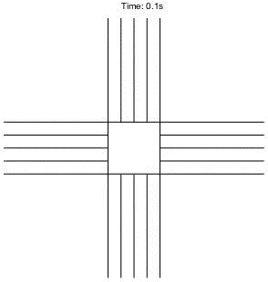
Ideal Intersection

Slide 6
Outline
Modeling
Note: not all following models will be used at the same time
Controlling Lengths of Traffic Lights
Intelligent Intersection Management
Imperfect Communication
Centralized and Distributed Approaches
Graph-Based Approach
Non-Cooperative Environment

Slide 7
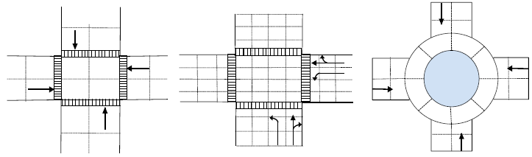
Tiles (Cells)
Usually, higher granularity, e.g., smaller tiles, more detailed management and higher complexity
Example: an intersection with 20 tiles
Example: an intersection with 64 tiles
Example: a roundabout with 24 tiles
Chen and Englund, "Cooperative intersection management: A survey," IEEE Transactions on Intelligent Transportation Systems, 2016.

Slide 8
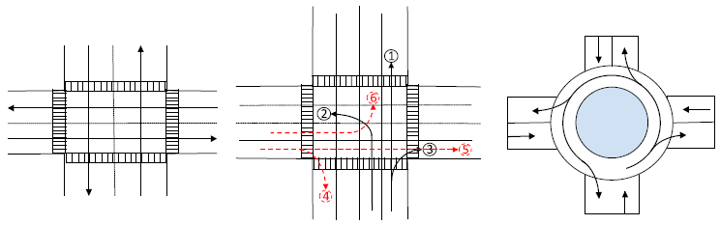
Trajectories
The trajectories for vehicles from different directions with different intentions follows "pre-defined" routes
Example: 1 trajectory for each direction of the intersection
Example: 3 trajectories for each direction of the intersection
Example: 4 trajectories for each direction of the roundabout
Chen and Englund, "Cooperative intersection management: A survey," IEEE Transactions on Intelligent Transportation Systems, 2016.

Slide 9
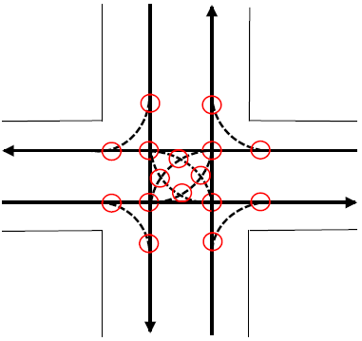
Collision Zones (Conflict Regions)
Intersections of trajectories
The fundamental goal
We should not let two vehicles occupy a collision zone or a tile at the same time
Chen and Englund, "Cooperative intersection management: A survey," IEEE Transactions on Intelligent Transportation Systems, 2016.

Slide 10
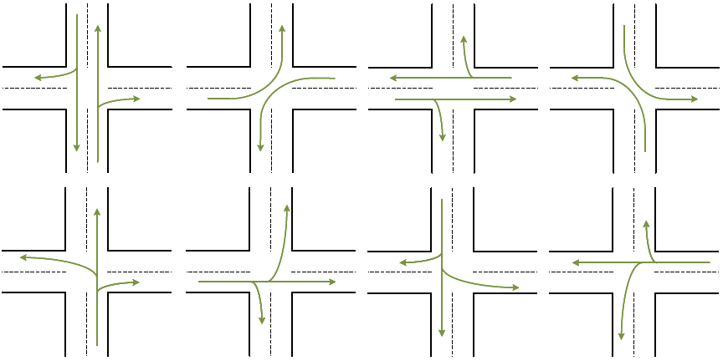
Phases
Example
8 phases of an intersection

Slide 11
Outline
Modeling
Controlling Lengths of Traffic Lights
Intelligent Intersection Management
Imperfect Communication
Centralized and Distributed Approaches
Graph-Based Approach
Non-Cooperative Environment

Slide 12
Controlling Lengths of Traffic Lights
Fixed time control
Coordinated control
Continuous green lights
Adaptive control
Design-time approach
Based on traffic data and history
Real-time approach
Based on sensor observation or communication

Slide 13
Back-Pressure Control: Method
Traffic flow is similar to water flow
Basic notation
λ_{i}: lane i
Q_{i}: queue length of lane i
P_{i}: pressure of lane i
P_{i} = Q_{i}
D_{i,j}: [0,1] there is a vehicle waiting at lane i to leave from lane i for lane j
P_{i,j}: pressure from lane i to lane j
P_{i,j} = D_{i,j} max(P_{i} – P_{j}, 0)
Each time slot, pick a phase which can maximize ∑_{(i,j)} V_{i,j} P_{i,j}
V_{i,j}: the maximum number of vehicles that can go from lane i to lane j in the phase during the time slot

Slide 14
Back-Pressure Control: Example
6
1
Computation
λ₁, λ₂, λ₃, λ₄, λ₅, λ₆
Q = {0, 2, 0, 1, 0, 1}
P = {0, 2, 0, 1, 0, 1}
D_{2,1} = D_{2,5} = D_{4,1} = D_{6,5} = 1
P_{2,1} = P_{2,5} = 2 and P_{4,1} = P_{6,5} = 1
Assume V_{i,j} is V or 0
Why 0?
(Check animations for phases)
∑_{(i,j)} V_{i,j} P_{i,j} = 4V for Phase 1
∑_{(i,j)} V_{i,j} P_{i,j} = 2V for Phase 2
∑_{(i,j)} V_{i,j} P_{i,j} = 3V for Phase 3
Pick Phase 1
To 5
5
To 1
To 5
2
4
To 1
3
6
1
5
2
4
3

Slide 15
Back-Pressure Control: Extensions
Capacity-aware back-pressure control
Remove the assumption of infinite capacity
Improve the fairness (for low density traffic)
Redefine P_{i} as another more complicated function
Adaptive max-pressure control
Model the network demand with a constant average rate
Provide some stability and performance guarantees
Redefine P_{i} as another more complicated function

Slide 16
Controlling Lengths of Traffic Lights
If the lengths of green, yellow, and red lights can be very short

Slide 17
Outline
Modeling
Controlling Lengths of Traffic Lights
Intelligent Intersection Management
Imperfect Communication
Centralized and Distributed Approaches
Graph-Based Approach
Non-Cooperative Environment

Slide 18
Assumptions
All vehicles are connected and autonomous
If not connected
Need road-side units to collect traffic information, e.g., vehicles coming
Need traffic lights to provide instructions
If not autonomous
Need to consider the control capability of human drivers

Slide 19
Goals
Safety
Traffic efficiency
Deadlock and starvation avoidance
Low communication and computation complexity
Incremental deployability
Protocol standardization
Dresner and Stone, "A multiagent approach to autonomous intersection management," Journal of Artificial Intelligence Research, 2008.

Slide 20
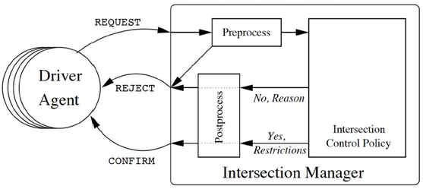
Intelligent Intersection Management
Vehicle
Send a request to the intersection manager about its intention
Do not enter the intersection before confirmation
Intersection manager
Resolve conflicts through scheduling policies
Allocate tiles (cells) to vehicles for every time step
Send confirmations or rejections to vehicles
Dresner and Stone, "A multiagent approach to autonomous intersection management," Journal of Artificial Intelligence Research, 2008.

Slide 21
Vehicle Behavior
Message types
REQUEST to make a reservation
CHANGE-REQUEST to change a reservation
REQUEST and CHANGE-REQUEST include all the relevant properties of the vehicle
CANCEL to cancel an existing reservation
DONE after crossing the intersection
CANCEL and DONE include the IDs of the vehicle and the reservation
Not enter the intersection if there is no confirmation from the manager
Dresner and Stone, "A multiagent approach to autonomous intersection management," Journal of Artificial Intelligence Research, 2008.

Slide 22
Manager Behavior
Message types
CONFIRM after approving a REQUEST or CHANGE-REQUEST
ID of the reservation
Start time
Start and departure lanes
A list of constraints for the vehicle's acceleration in the intersection
REJECT to reject a REQUEST or CHANGE-REQUEST
ACKNOWLEDGE to respond a CANCEL or DONE
EMERGENCY-STOP when detecting a major problem
Control policies
First come (definition?), first served
"Virtual" stop sign
"Virtual" traffic light
Dresner and Stone, "A multiagent approach to autonomous intersection management," Journal of Artificial Intelligence Research, 2008.

Slide 23
Outline
Modeling
Controlling Lengths of Traffic Lights
Intelligent Intersection Management
Imperfect Communication
Centralized and Distributed Approaches
Graph-Based Approach
Non-Cooperative Environment

Slide 24
Modeling Vehicle Behavior
[4s,5s]: example time of feasible "entering" the intersection
This is a logical view --- the number can be estimated by the manager
Reasons of slowing down
Sense the intersection in front and not receive a confirmation
Sense other vehicles in front
Not doable /
Not Requested Yet
Approaching / REQUEST [4,5]
Requested
CONFIRM [5,6] /
Confirmed
Changing status 2 / CANCEL or REJECT /
Changing status 1 / CHANGE-REQUEST [5,6]
Doable /
Entered
Changing status 2 / CANCEL or REJECT /
Requested (Changed)
CONFIRM [5,6] /
Leaving intersection / DONE
Changing status 1 / CHANGE-REQUEST [6,7]
Left

Slide 25
Imperfect Communication: Loss
Informal analysis
Case 1/2: What if a REQUEST/CHANGE-REQUEST is lost?
Case 3: What if a CANCEL is lost?
Case 4: What if a DONE is lost?
Case 5: What if a CONFIRM is lost?
Case 6: What if a REJECT is lost?
Case 7: What if an ACKNOWLEDGE is lost?
Case 8: What if an EMERGENCY-STOP is lost?
Ideally, we should have "formal analysis"
Having "timeouts" is important
Re-request a reservation (Cases 1, 2, 5, 6)
Logically remove a vehicle after physically checking the intersection? (Case 4)

Slide 26
Imperfect Communication: Delay
Informal analysis
Case 1/2: What if a REQUEST/CHANGE-REQUEST is delayed?
Case 3: What if a CANCEL is delayed?
Case 4: What if a DONE is delayed?
Case 5: What if a CONFIRM is delayed?
Case 6: What if a REJECT is delayed?
Case 7: What if an ACKNOWLEDGE is delayed?
Case 8: What if an EMERGENCY-STOP is delayed?
Combinations of message loss and delay
How do you know which vehicle is in front?
Having "time stamps" can help
Synchronization protocol?

Slide 27
Imperfect Communication: More
Schedule only when 1st vehicle requests (otherwise?)
We assume that each vehicle knows if it is 1st vehicle and provides this information to the manager
X |  | Missing X-Request | Missing X-Confirmation
1st Vehicle | Manager | Schedule nothing (1st vehicle missing) | Schedule all vehicles
 | 1st Vehicle | Slow down, timeout, re-request | Slow down, timeout, re-request
 | 2nd Vehicle | Slow down, timeout, re-request | Slow down, cannot make it, re-request
 | 3rd Vehicle | Slow down, timeout, re-request | Slow down, cannot make it, re-request
2nd Vehicle | Manager | Schedule 1st and 3rd vehicles | Schedule all vehicles
 | 1st Vehicle | Normal | Normal
 | 2nd Vehicle | Slow down, timeout, re-request | Slow down, timeout, re-request
 | 3rd Vehicle | Slow down, cannot make it, re-request | Slow down, cannot make it, re-request
3rd Vehicle | Manager | Schedule 1st and 2nd vehicles | Schedule all vehicles
 | 1st Vehicle | Normal | Normal
 | 2nd Vehicle | Normal | Normal
 | 3rd Vehicle | Slow down, timeout, re-request | Slow down, timeout, re-request

Slide 28
Outline
Modeling
Controlling Lengths of Traffic Lights
Intelligent Intersection Management
Imperfect Communication
Centralized and Distributed Approaches
Graph-Based Approach
Non-Cooperative Environment

Slide 29
System Block Diagram: Centralized
The manager is the decision maker
Vehicle i
Manager (Decision Making)
Receiver
Vehicle 1
Constraints from Manager
Motion Planning
Sender
Vehicle 2
Time to Occupy
Conflict Zones
Trajectory
Vehicle 3
Controller
Vehicle 4

Slide 30
Flow of Execution: Centralized
Each task should be completed in time
Time
Decision Making
Communication
Motion Planning
Controller

Slide 31
System Block Diagram: Distributed
Each vehicle is a decision maker
Vehicle i
Decision Making
Receiver
Other Vehicles'
Information
Vehicle 1
Constraints
Motion Planning
Sender
Vehicle 2
Time to Occupy
Conflict Zones
Trajectory
Vehicle 3
Controller
Vehicle 4

Slide 32
Flow of Execution: Distributed
Each task should be completed in time
Time
Communication
Decision Making
Motion Planning
Controller

Slide 33
Outline
Modeling
Controlling Lengths of Traffic Lights
Intelligent Intersection Management
Imperfect Communication
Centralized and Distributed Approaches
Graph-Based Approach
Non-Cooperative Environment

Slide 34
Graph-Based Policy
The decision making problem in intersection management can be transformed to a cycle-removal problem in a graph
Generalization
Conflict-resolution problem
The goal: we should not let two vehicles occupy a conflict zone (or a tile) at the same time
Distributed intersection management
Does it make sense to have no manager?
If vehicles (even from different OEMs) agree how to remove a cycle, then "conflict-free" can be guaranteed
Cycle-removal algorithm is the "agreement" between vehicles (e.g., four-way stop sign) in a distributed setting
We have an existing system in …

Slide 35
Intersection
Intersection
There is one intersection
Intersection manager
Receive the information from vehicles
Assign a time window to each vehicle at each location (conflict zone) on the trajectory of the vehicle
(( ))
(( ))
Roadside Unit
(( ))
(( ))
(( ))

Slide 36
Vehicle
Vehicle
All vehicles are connected and autonomous
Each vehicle has a fixed trajectory
Vehicle does not change lanes before and after the intersection
(( ))
(( ))
Roadside Unit
(( ))
(( ))
(( ))

Slide 37
Conflict Zone
Conflict zone
A conflict zone is the crossing location of two trajectories
Two vehicles cannot be at (occupy) the same conflict zone at the same time
Conflict Zone

Slide 38
Timing Conflict Graph
Timing conflict graph
A directed timing conflict graph G = (V, E) is constructed
Vertex set v_{i,j} is a subset of the Cartesian product of the sets of vehicles and conflict zones
Edge
Type-1: same vehicle's trajectoty
Type-2: conflicts between different vehicles from the same lane
Type-3: conflicts between different vehicles from different lanes
4
1,1
1,2
1,3
3,3
4
3
3
Type-1
Type-2
1
1
2
2
2,1
4,1
4,4
3,4
Type-3

Slide 39
Model Expressiveness
If the intersection is modeled by only one conflict zone
Its expressiveness is limited, and the two vehicles cannot enter the intersection at the same time
If the intersection is modeled by four conflict zones
Two vehicles can enter the intersection at the same time
1,1
Type-1
1
2
Type-2
Type-3
1
2,1
1,1
1,2
1,3
4
3
2
1
1
2
2,1
2,4
2,3

Slide 40
Goals
A cycle-removal algortihm to
Minimize
The passing time of the last vehicle, or
The average delay of vehicles
Guarantee collision-freeness
Provided by the passing order and scheduling after removing cycles
Guarantee deadlock-freeness
Graph-based verification
Petri-Net-based verification
4
1,1
1,2
1,3
3,3
4
3
3
Type-1
Type-2
1
1
2
2
2,1
4,1
4,4
3,4
Type-3

Slide 41
Graph-Based Verification
Having no cycles in G does not guarantee deadlock-freeness
There are deadlocks in (a), (b), (c)
There are no deadlocks in (d), (e)
1,1
1,2
1,1
1,3
1,1
1,3
2,1
2,2
2,1
2,2
2,3
2,1
2,2
(a)
(b)
(c)
1,1
1,2
1,1
1,3
3,2
3,3
Type-1
2,1
2,2
2,1
2,2
2,3
Type-2
Type-3
(d)
(e)

Slide 42
Graph-Based Verification
Construction of resource conflict graph
The directed resource conflict graph is constructed by following rules
i, j
i, j'
i, j''
i, j
i, j'
i, j, j'
i, j'
i, j
i, j', j
i, j, j'
i, j', j''
i', j
i', j''
i', j, j''
i', j''
i', j
i', j'', j
(a)
i, j
(b)
(c)
v_{i, j} in G'
i, j
i, j'
i, j, j'
i, j'
i, j
i, j', j
i, j, j'
u_{i, j, j'} in H'
i', j''
i', j
i', j'', j
i', j
i', j''
i', j, j''
(d)
(e)

Slide 43
Graph-Based Verification
Examples of resource conflict graph
1,1,2
1,1,3
1,1,3
1,1
1,2
1,1
1,3
1,1
1,3
2,1,2
2,1,2
2,2,3
2,1,2
2,1
2,2
2,1
2,2
2,3
2,1
2,2
(a)
(b)
(c)
3,2,3
3,2
3,3
1,1,2
1,1,3
1,1
1,2
1,1
1,3
2,1,2
2,1,2
2,2,3
G'
2,1
2,2
2,1
2,2
2,3
H'
(d)
(e)

Slide 44
Petri-Net-Based Verification
Petri Net Examples
1,1
1,2
1,1
1,3
1,1
1,3
1,in
1,out
1,in
1,out
1,in
1,out
1,2,1
2,1,2
1,2,1
2,1,3
1,2,1
3,1,3
2,1
2,2
2,1
2,2
2,3
2,1
2,2
2,in
2,out
2,in
2,out
2,in
2,out
(a)
(b)
2,3,2
1,1
1,2
1,1
1,3
1,in
1,out
1,in
1,out
3,2
3,3
1,2,1
1,2,2
2,1,1
1,2,3
3,in
3,out
(c)
2,1
2,2
2,1
2,2
2,3
2,in
2,out
2,in
2,out
Place
Transition
Arc
Token
Edge in G'
(d)
(e)

Slide 45
Summary
A cycle-removal algortihm (not covered today) to
Minimize
The passing time of the last vehicle, or
The average delay of vehicles
Guarantee collision-freeness
Provided by the passing order and scheduling after removing cycles
Guarantee deadlock-freeness
Graph-based verification
Petri-Net-based verification
4
1,1
1,2
1,3
3,3
4
3
3
Type-1
Type-2
1
1
2
2
2,1
4,1
4,4
3,4
Type-3

Slide 46
Outline
Modeling
Controlling Lengths of Traffic Lights
Intelligent Intersection Management
Imperfect Communication
Centralized and Distributed Approaches
Graph-Based Approach
Non-Cooperative Environment

Slide 47
Game Theory
What is a game?
Prisoner's dilemma
A Game
Multiple Rational Decision Makers
Players
Decisions
Actions
Conflicting Interests
Objectives
 | Prisoner A Stays Silent | Prisoner A Betrays
Prisoner B Stays Silent | Both in Jail for 1 Year | A Goes Free B in Jail for 3 Years
Prisoner B Betrays | A in Jail 3 Years B Goes Free | Both in Jail for 2 Years (Nash Equilibrium)

Slide 48
Two-Vehicle Scenario (w/o Manager)
Payoff matrix (waiting time) of vehicles A and B
Case 1 (same priority)
Case 2 (Vehicle A has a higher priority)
Where are the Nash Equilibria?
Are them realistic? → People are not rational (------)
Payoffs of A and B | Vehicle A Enters | Vehicle A Stops
Vehicle B Enters | (-3600, -3600) | (-4, 0)
Vehicle B Stops | (0, -4) | (-3, -3) (Average of -1 and -5)
Payoffs of A and B | Vehicle A Enters | Vehicle A Stops
Vehicle B Enters | (-1800, -7200) | (-4, 0)
Vehicle B Stops | (0, -4) | (-1, -5)

Slide 49
Three-Vehicle Scenario (with Manager)
Three-vehicle strategic game
Assume that the time needed to go through an intersection is 7
Vehicle C does not worsen the overall system performance
Total delays = 9
However, Vehicle C can take advantage from it
No Vehicle lies
Vehicle | Actual Time | Reported Time | Allocated Time | Delay
A | 5 | 5 | 5 | 0
B | 10 | 10 | 12 | 2
C | 12 | 12 | 19 | 7
System Performance |  |  |  | 9
Vehicle C Lies
Vehicle | Actual Time | Reported Time | Allocated Time | Delay
A | 5 | 5 | 5 | 0
B | 10 | 10 | 19 | 9
C | 12 | 6 | 12 | 0
System Performance |  |  |  | 9

Slide 50
Q&A

